Slide 1
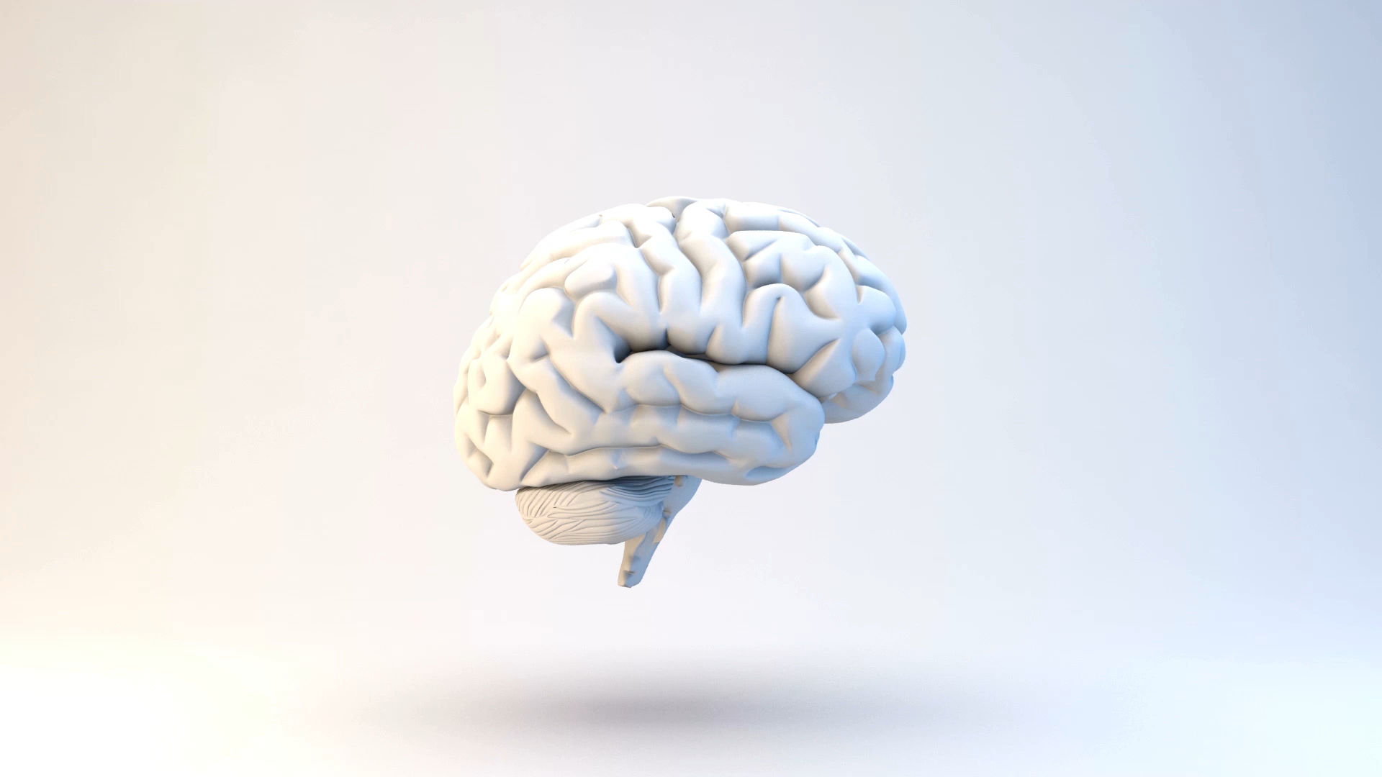
Neural Network Approach to the Inverse Problem
Using feed forward and convolutional neural network to solve the inverse problem in EEG Source Localization

Slide 2
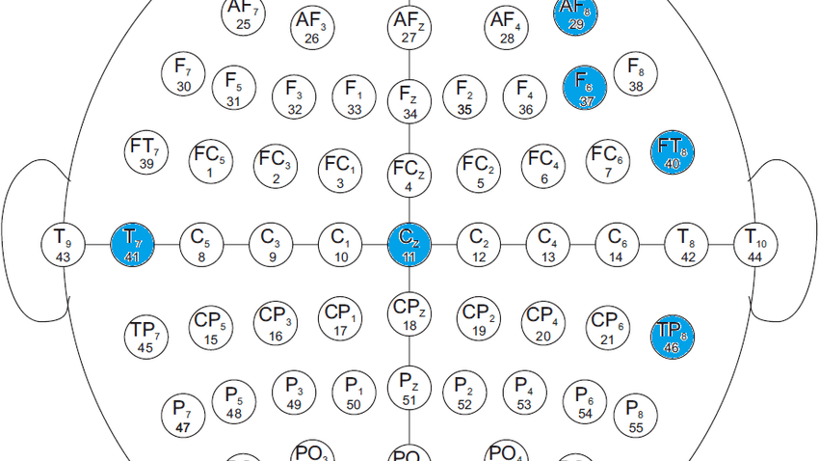
Electroencephalogram
Cheap and efficient
High temporal resolution (around 6ms)
Information loss and low spatial resolution

Slide 3
Source Localization
Methods that analyze the source of neural activity
Consists of the Forward Model and the Inverse model
Brain is split up into dipoles

Slide 4

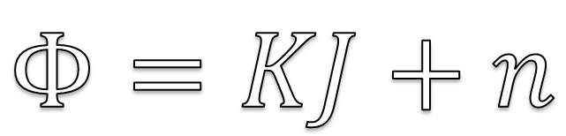
Source Localization: Forward Model
Simulation of data
Projection matrix
Noise
$$Φ=KJ+n$$

Slide 5
Source Localization: Inverse Problem
Ill posed problem
Inverse projection matrix
Spread of neural activity
3D to 2D
Mostly mathematical

Slide 6
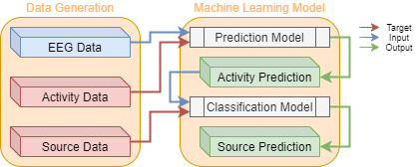
Methodology
Forward Model → Data Generation
Inverse Model → Machine Learning Model
Data is split up in trials

Slide 7

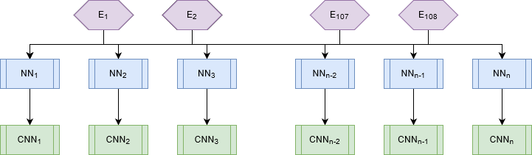
Machine Learning Model
There 108 electrodes present
Each dipole has a corresponding Standard Neural Network and Convolutional Neural Network

Slide 8
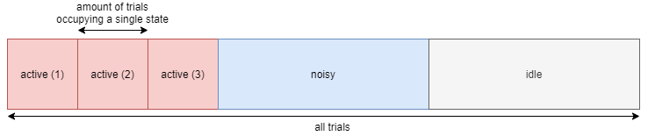
Data Generation: State Determination
Each dipole is in one state during the whole trial
The states of the dipoles differ in their neural activity
There are 3 active (source) dipoles
There are n/2 noisy dipoles

Slide 9
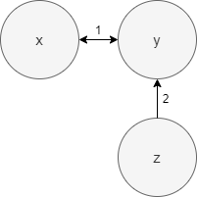
Data Generation: Neural Activity Simulation
Active: AR(1) process:
The connectivity of each source dipole differs
Noisy: pink noise characterized by 1/f shaped power
Idle: no recorded dipole magnitude

Slide 10

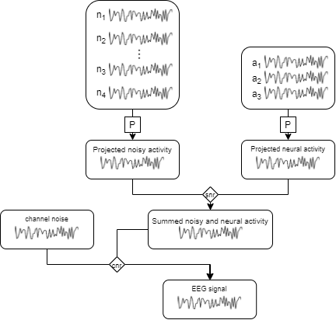
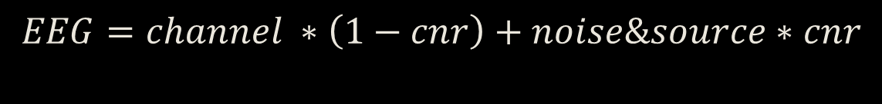
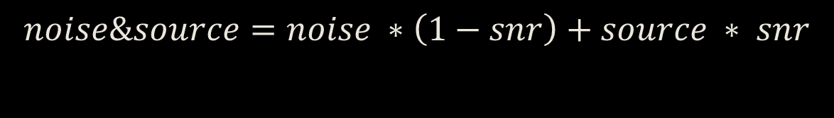
Data Generation: Projection
Noise ratio’s: Signal to noise (snr) & Channel Noise (cnr)
Projection matrix from Huang et al. (2016)
$$noise\&source=noise ∗\left(1−snr\right)+source ∗ snr$$
$$EEG=channel ∗\left(1−cnr\right)+noise\&source∗cnr$$

Slide 11
Time Series Prediction
The data input is of size 108
(electrodes)
The data output is of size 1
(dipole magnitude)
Hyper parameters: Batch sizes, Adam optimizer, MSE, learning rate, nodes (1 hidden layer)

Slide 12
Time Series Classification
The output is the state of the dipole
1 if active (source)
0 if noisy or idle
Hyper Parameters: Convolutional Nodes, Kernel Size, Stride, Dense Nodes, Batch size, Adam Optimizer, Log loss, learning rate

Slide 13
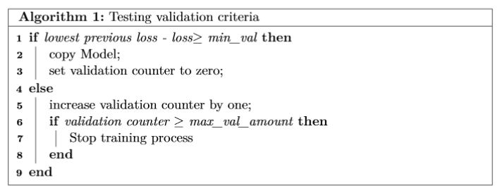
Validation
Hyper parameters: Max validation fails, Validation frequency, minimum Validation performance increase

Slide 14
Performance Measures
Prediction: Mean Squared Error
Classification: True Positive, True Negative, Dipole Accuracy
Dipole accuracy: choosing the correct three source dipoles

Slide 15
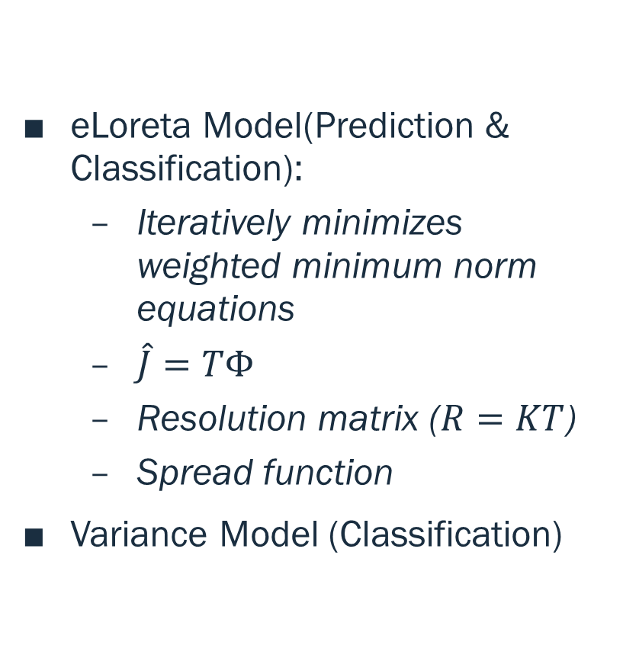
Benchmark Models
eLoreta Model(Prediction & Classification):
Iteratively minimizes weighted minimum norm equations
$\hat{J}=TΦ$
Resolution matrix ($R=KT$)
Spread function
Variance Model (Classification)

Slide 16
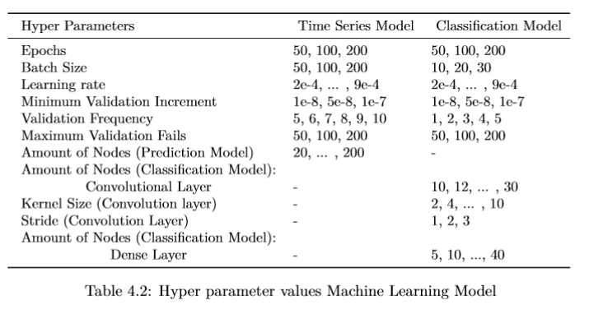
Gridsearch
Trials: 1000
Timesteps: 100
Dipoles: 1000
Bayesian Tuning
Fixed set of dipoles
628 billion options

Slide 17
Evaluation: Prediction
Research Questions:
What is the difference between prediction of dipoles near the scalp and at the center
Is there a difference when active sources are close to each other
Are there significant differences between the outputs of the different neural networks
Are the optimal hyper parameters similar for all neural networks
Is the dipole that is not influenced by others easier to simulate
Benchmark:
How does the model compare in terms of MSE performance

Slide 18
Evaluation: Classification
Research Questions:
How confident is the model
How do noisy and idle time series differ
Benchmark models:
Use the Variance model on both the prediction output of the eLORETA and the Machine Learning model
Use the Machine Learning Classification model on the output of the eLORETA
How does the model compare in terms of TN, TP and dipole accuracy

Slide 19
Future Work & Discussion
Improving the prediction model by implementing an RNN
Using 1 CNN instead of n different ones
Training using a data set where each dipole occupies the active state
Using concepts of previous mathematical models

Slide 20

Questions

